Slide 1
Qlik Cloud’s Container Journey
Jim Reed R&D Manager – Scalable Nodes & Elastic Services
April 12, 2018

Slide 2
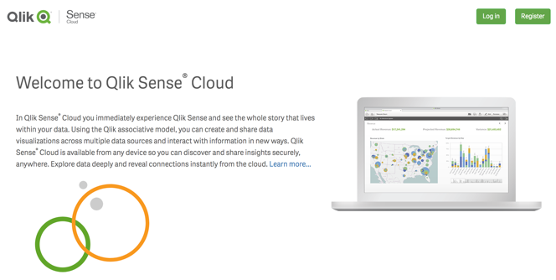
Agenda
Qlik Sense Cloud’s Container Journey
Our Starting Point
Where we are today
What we learned
Future

Slide 3
About Qlik
Elastically Scalable
Cloud/Hybrid Architecture
SaaS cloud products
Traditional on-premise software product
BI Software Company
40,000+ customers
2500 employees
On a SaaS & cloud journey
R&D Labs in Sweden, Boston, Italy, Iceland, Ottawa
100 employees in Ottawa
Qlik

Slide 4
Our Starting Point
Cloud specific hub, orchestrated Qlik sessions and app placement, ecommerce, login, etc.
Qlik Cloud “App”
boxes
Windows boxes
Windows Qlik Sense sessions for read and create.
Qlik Sense Windows
Notes:
about 3 years

Slide 5
Challenges
Qlik Cloud “App”
Difficult to auto-scale Windows sense servers (so we overprovisioned servers to handle peak load).
Release upgrades were painful.
Deployment process was slow and required outages.
Hard to scale development across a large team.
Operations depended on a small number of overworked developers.
boxes
Windows boxes
Qlik Sense Windows
Notes:
Autoscale challenges...overprovisioning
Deploying on a Saturday... pilot / co-pilot cockpit story

Slide 6
Qlik Sense Cloud - Today
Qlik Cloud “App”
Cloud app broken into microservices
Qlik Cloud “App” Microservices
boxes
Engine Container sessions for read
Engine Container
Engine Container
Windows boxes
Qlik Sense Windows
Engine Container
Engine Container
Windows Qlik Sense sessions for create

Slide 7
What we changed
Qlik Cloud “App”
Qlik Cloud “App” Microservices
Microservices architecture
Linux QIX engine
Docker containers
Container orchestration
Production hardening
Continuous delivery
boxes
Engine Container
Engine Container
Windows boxes
Qlik Sense Windows
Engine Container
Engine Container

Slide 8

Microservices architecture
Developing software applications as a suite of independently deployable, small, modular services.

Slide 9
Why we like it
Allows a team to focus on developing a high quality service with a well defined contract that is easy to change and test independently of the rest of the system.
Improves quality.
Much easier to change and evolve code.
Easier to scale out development.
Easier to distribute operational workload.
Notes:
It is much easier to get 90% automated coverage of a microservice than a monolith. It's too easy to bypass a service contract in a monolith.

Slide 10
Linux QIX Engine
QIX Engine was ported to Linux last year.
Also includes a number of improvements for cloud:
Cloud metrics.
Improved container and orchestration support.
Qlik Sense Windows
Linux Engine

Slide 11
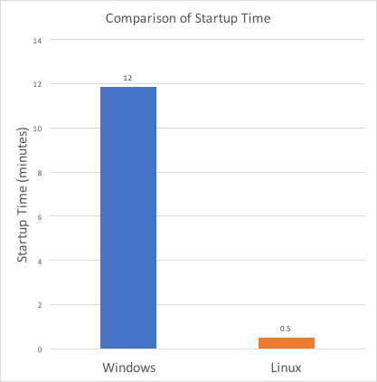
Why we like the Linux engine
Linux has much less overhead than windows.
Fast to provision.
More flexible, easy to work with.
Lower cost.
Well suited for commodity (cloud) hardware.
Well suited for containers and orchestration.

Slide 12
Docker containers
Bundling an application with all of it’s dependencies into a single self contained package.
Always runs the same way in any environment.
Very fast to start and stop, efficient use of system resources.

Slide 13
Why we like containers
Standardize your microservice development environment, can build and test the same way on your laptop as in the cloud.
Easy to connect containers together so that you can abstract dependencies to other services.
Super fast to start/stop containers.
Efficient use of resources.
Portable, easy to move across cloud vendors.
Well suited for cloud, microservices and continuous delivery.
Consistent way for operations to interact with microservices.

Slide 14
Container orchestration
Container Orchestration
A container management system.
Effectively organizes a group of containers across a set of servers.
Makes sure containers stay up, simplifies their management in production.
Containers
Kubernetes
Servers
Docker Swarm

Slide 15
Why we like orchestration
Define your service requirements and let the orchestrator do the work: I want three instances of this container type with this much RAM and CPU
Auto-scaling
Security
Monitoring health checks
Load balancing
Volume management
Rolling updates

Slide 16
How We Use Orchestration Today:
Linux Engine for Viewing Apps
Qlik Cloud “App”
Qlik Cloud “App” Microservices
boxes
Windows boxes
Engine Container
Engine Container
Qlik Sense Windows
Engine Container
Engine Container

Slide 17
Production Hardening
“Getting it working is only 25% of the work”

Slide 18
Our Cloud Safety Net
Cloud Safety Net
Metrics dashboards
Performance testing
Health-checks
Alerts
Monitoring
Unit testing
Security testing
System testing
Code reviews
Continuous delivery
Logging
Integration testing
Deployment pipeline

Slide 19
Logging & Monitoring
A great start is to capture information about traffic and errors.

Slide 20
Resource Consumption
before
Resource Consumption Dashboard during performance tests. These tests were executed before and after stability bug fixes.
Memory leak before but not after
after
Docker mistakenly restarting engine before but not after
Notes:
thorough round of performance testing

Slide 21
Metrics Monitoring
Engine Memory Usage
Apps Loaded
Metrics Monitoring - Engine Metrics collected during the performance tests helped to diagnose the source of Docker container crashes.
Sessions Per User
Cache Hit Rate

Slide 22
SLI & SLO
SLI - Service Level Indicator: a quantitative measure of some aspect of the level of service that is provided (e.g. "the latency of GET requests")
SLO - Service Level Objective: a target value or range of values for a service level that is measured by an SLI (e.g. "99.9% of GET requests must be handled in less than 100ms")
From Google's "SRE" book

Slide 23
Things we’ve learned
Our cloud safety net was a big investment but well worth it.
Allowed us to go-live with confidence.
Much faster to debug complex issues.
Allows us to find/fix issues before customers see them.
We are able to answer questions like:
How many people are using my feature?
How many requests have they made?
How many errors have they had?

Slide 24
What is continuous delivery?
What is Continuous Delivery?
Rather than deploy large batches to production
code commit
feature
prod
feature
deployment pipeline

Slide 25
What is continuous delivery?
Continuous Delivery
can always release to prod
deploy smaller batches
build a deployment rhythm
Deploy small batches instead
feature
prod
feature
deployment pipeline

Slide 26
Why we like it
Easier to deploy without downtime.
Fewer code changes, lowers risk.
Quicker, better feedback, quicker to find/fix issues.
You get good at deploying when you do it a lot.
Better feedback => higher quality.

Slide 27
What we recommend
Increase release upgrade frequency, if you can.
Maybe not daily or weekly, but monthly would be good.
You get good at it when you make it routine.

Slide 28
Additional Tip: Release Features as a series of experiments
Go-Live Release Experiments:
In prod dark, feature flag testing
Experiment with a small group of users
Experiment with all employees
Go-Live Experiment with all users
Notes:
controlled release plan

Slide 29
Release Experiment
actual results
expected results
Collect data and compare expected
results to actual results
If the results are bad, fix bugs and repeat

Slide 30
Qlik Sense Cloud - Future
Qlik Cloud specific components, e.g., ecommerce
Qlik Cloud “App”
Qlik Cloud “App” Microservices
Qlik Sense platform in containers sessions for everything.
Qlik Sense
Qlik Sense
Qlik Sense
Qlik Sense

Slide 31
What we are changing
Qlik Cloud “App”
Qlik Cloud “App” Microservices
Moving to Kubernetes
More microservices
Hybrid architecture
Qlik Sense
Qlik Sense
Qlik Sense
Qlik Sense

Slide 32
Kubernetes Basics
Masters
Nodes
Pods
ReplicaSets
Deployments
Services
LoadBalancer
NodePort
ClusterIP
Ingress
PersistentVolume
PersitentVolumeClaim
Pod
Node
Node
Node
Master
Node
Node
Node
K8s cluster

Slide 33
What we like about Kubernetes
Feature rich:
Stateful service support
Built in auto-scaling
Cron jobs
Ingress (abstraction of routing rules)
Huge community adding more features:
Helm
Service Mesh
Lots of momentum
Written in go ☺
Direction is set by open source community
Based on experience solving problems faced by Google

Slide 34
Questions?

Slide 35
Thank you!

